Slide 1
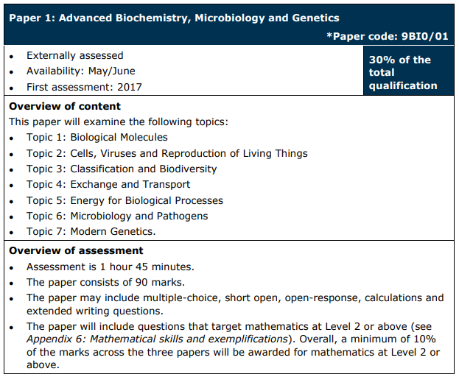

Slide 2
Paper: | A level paper 1 | Done?
Topic & web link: | Topic 1 Biological molecules: Edexcel (B) Biology A-level Topic 1: Biological Molecules Revision - PMT (physicsandmathstutor.com)
 | Topic 2 Cells, Viruses and reproduction: Edexcel (B) Biology A-level Topic 2: Cells, Viruses & Reproduction Revision - PMT (physicsandmathstutor.com)
 | Topic 3 Classification and biodiversity: Edexcel (B) Biology A-level Topic 3: Classification and Biodiversity Revision - PMT (physicsandmathstutor.com)
 | Topic 4 Exchange and transport: Edexcel (B) Biology A-level Topic 4: Exchange and Transport Revision - PMT (physicsandmathstutor.com)
 | Topic 5 Energy and biological processes: Edexcel (B) Biology A-level Topic 5: Energy for Biological Processes Revision - PMT (physicsandmathstutor.com)
 | Topic 6 Microbiology and pathogens: Edexcel (B) Biology A-level Topic 6: Microbiology and Pathogens Revision - PMT (physicsandmathstutor.com)
 | Topic 7 Modern genetics: Edexcel (B) Biology A-level Topic 7: Modern Genetics Revision - PMT (physicsandmathstutor.com)
 | Practical skills: Edexcel (B) Biology A-level Practical Skills - PMT (physicsandmathstutor.com)

Slide 3
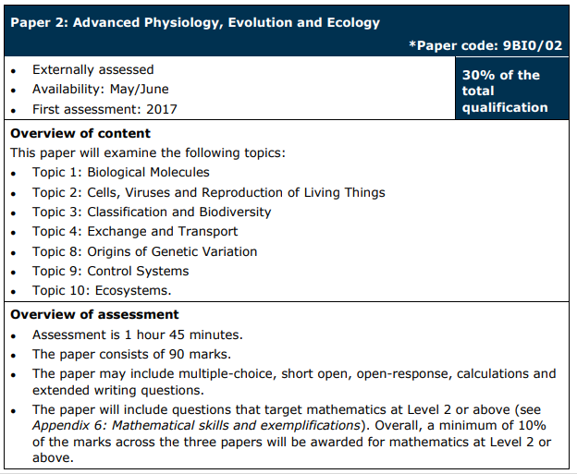

Slide 4
Paper: | A level paper 2 | Done?
Topic & web link: | Topic 1 Biological molecules: Edexcel (B) Biology A-level Topic 1: Biological Molecules Revision - PMT (physicsandmathstutor.com)
 | Topic 2 Cells, Viruses and reproduction: Edexcel (B) Biology A-level Topic 2: Cells, Viruses & Reproduction Revision - PMT (physicsandmathstutor.com)
 | Topic 3 Classification and biodiversity: Edexcel (B) Biology A-level Topic 3: Classification and Biodiversity Revision - PMT (physicsandmathstutor.com)
 | Topic 4 Exchange and transport: Edexcel (B) Biology A-level Topic 4: Exchange and Transport Revision - PMT (physicsandmathstutor.com)
 | Topic 8 Origins of genetic variation: Edexcel (B) Biology A-level Topic 8: Origins of Genetic Variation Revision - PMT (physicsandmathstutor.com)
 | Topic 9 Control systems: Edexcel (B) Biology A-level Topic 9: Control Systems Revision - PMT (physicsandmathstutor.com)
 | Topic 10 Ecosystems: Edexcel (B) Biology A-level Topic 10: Ecosystems Revision - PMT (physicsandmathstutor.com)
 | Practical skills: Edexcel (B) Biology A-level Practical Skills - PMT (physicsandmathstutor.com)

Slide 5
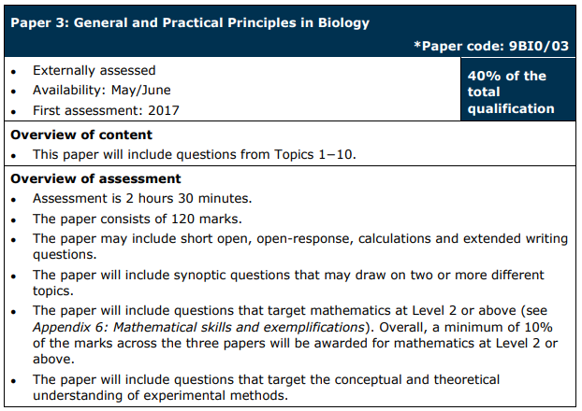

Slide 6
Paper: | A level paper 3 | Done?
Topic & web link: | Topic 1 Biological molecules: Edexcel (B) Biology A-level Topic 1: Biological Molecules Revision - PMT (physicsandmathstutor.com)
 | Topic 2 Cells, Viruses and reproduction: Edexcel (B) Biology A-level Topic 2: Cells, Viruses & Reproduction Revision - PMT (physicsandmathstutor.com)
 | Topic 3 Classification and biodiversity: Edexcel (B) Biology A-level Topic 3: Classification and Biodiversity Revision - PMT (physicsandmathstutor.com)
 | Topic 4 Exchange and transport: Edexcel (B) Biology A-level Topic 4: Exchange and Transport Revision - PMT (physicsandmathstutor.com)
 | Topic 5 Energy and biological processes: Edexcel (B) Biology A-level Topic 5: Energy for Biological Processes Revision - PMT (physicsandmathstutor.com)
 | Topic 6 Microbiology and pathogens: Edexcel (B) Biology A-level Topic 6: Microbiology and Pathogens Revision - PMT (physicsandmathstutor.com)
 | Topic 7 Modern genetics: Edexcel (B) Biology A-level Topic 7: Modern Genetics Revision - PMT (physicsandmathstutor.com)
 | Topic 8 Origins of genetic variation: Edexcel (B) Biology A-level Topic 8: Origins of Genetic Variation Revision - PMT (physicsandmathstutor.com)
 | Topic 9 Control systems: Edexcel (B) Biology A-level Topic 9: Control Systems Revision - PMT (physicsandmathstutor.com)
 | Topic 10 Ecosystems: Edexcel (B) Biology A-level Topic 10: Ecosystems Revision - PMT (physicsandmathstutor.com)
 | Practical skills: Edexcel (B) Biology A-level Practical Skills - PMT (physicsandmathstutor.com)

